Slide 1

Two sample hypothesis test
By Amrita Panjwani

Slide 2

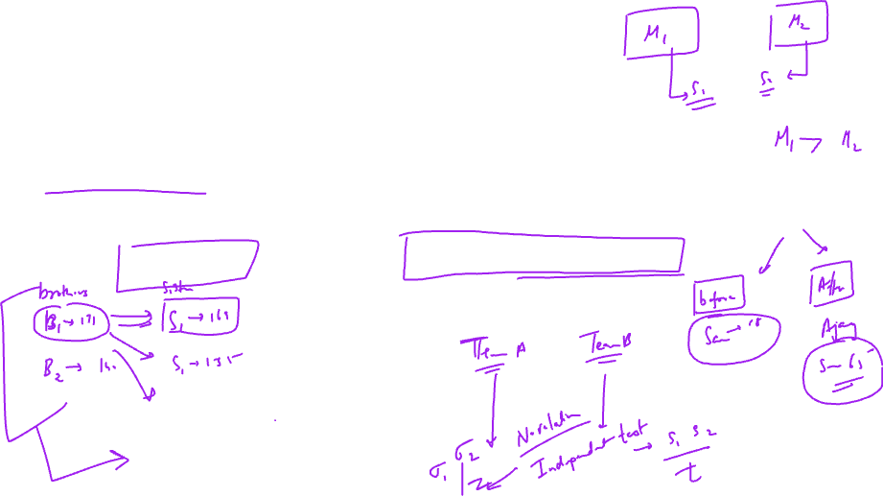
Two sample mean test
When the researcher is interested to compare the mean values of two different populations, a two sample mean test is employed.
There are two scenarios:
When two samples are related a two sample paired T test is used
When two samples are independent either a Z test or T test is used based on the population standard deviation values
If population standard deviation values of the two populations is provided two sample Z test is used, else a two sample T test is used

Slide 3
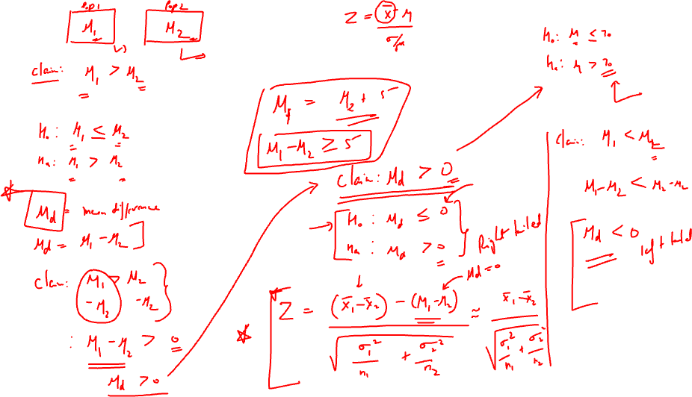

Slide 4


Paired T test
When the two populations are either related or same , the Paired T test is used
Related samples: Brother-sister , husband wife
Same sample: before the training measurements and after the training measurements, before and after score measurements

Slide 5


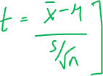
Formula of Paired sample Test
.d = mean of difference of each pair
.S_{d} = standard deviation of differences
.µ_{d =} Claimed mean difference
.n = sample size

Slide 6

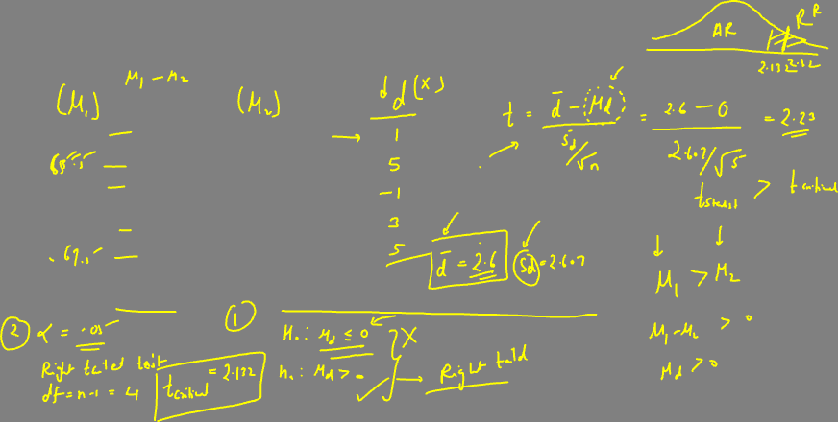
Example
Consider the below data of weight loss of 5 samples
Test the claim that the weight loss program is effective
Before | After
68 | 67
70 | 65
58 | 59
60 | 57
72 | 67

Slide 7
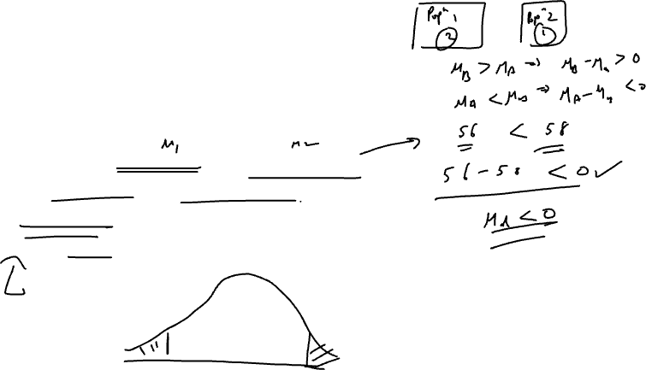
Solution
To test the claim that weight loss program is effective
This implies that the weight after < weight before
Or we can say: after weight – before weight < 0
Let d denote difference: d = after – before weight
To test claim that d < 0
Hence the hypothesis:
Null hypothesis: Ho: µ_{d} ≥ 0
Alternate hypothesis: Ha: µ_{d} < 0
Significance level = 5%

Slide 8

Test Statistic calculation
.d = (-1-5+1-3-5)/5 = -2.6
. Sd = 2.61
T = (-2.6 -0) / (2.61/√5)
T = -2.2275
Before | After | d = after - before
68 | 67 | -1
70 | 65 | -5
58 | 59 | 1
60 | 57 | -3
72 | 67 | -5

Slide 9
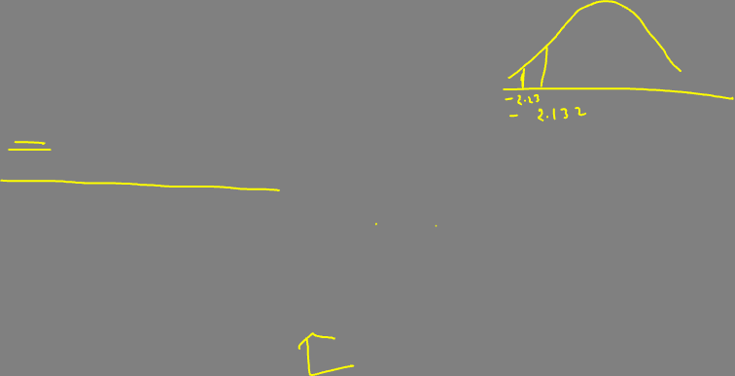
Inference:
Df = 5-1 = 4
T critical = -2.132
T statistic -2.2275 < T critical -2.132
Hence it falls in rejection region
Decision: Reject the null hypothesis
Conclusion: There is significant evidence to support the claim that the weight loss program is effective

Slide 10
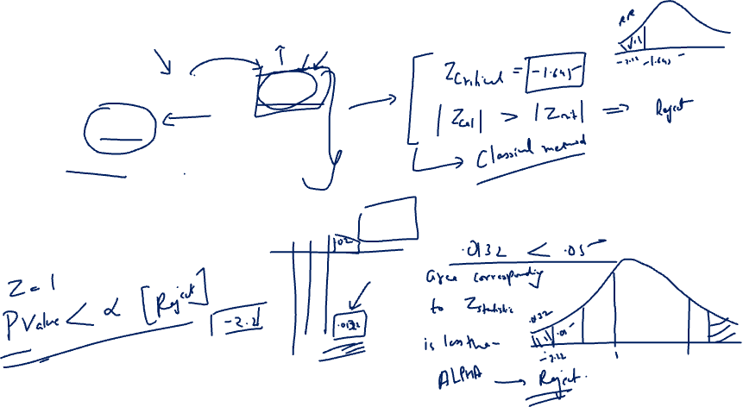
Example to understand what is P value ?
Suppose: Z calculated is: -2.22
Alpha = 0.05
Left tailed test
Can you find the area to the left of -2.22 using the Z table ?

Slide 11
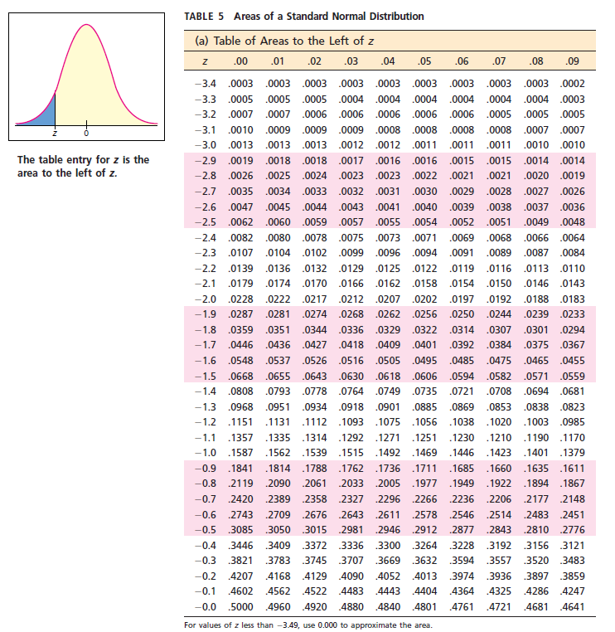

P( z < -2.22) = 0.0132
This value of probability corresponding to the Z calculated is called: PVALUE
PVALUE DECISION RULE:
If P VALUE < Alpha, reject the null

Slide 12

P value Method
Decision rule: if P value < alpha , reject the null hypothesis. Because a lower P value indicates that the difference is SIGNIFICANT.
P VALUE is also understood as ‘Chance of null hypothesis to be true’
So a low P value indicates less chance of null to be true and hence it is rejected
P value decision rule:
P value < alpha , reject
Critical value decision rule:
|z calculated| > | z critical | , reject

Slide 13
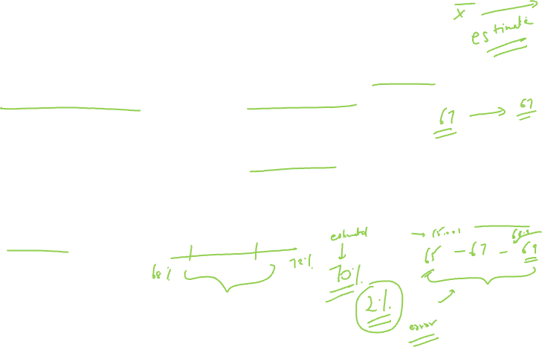
Estimation
The process of drawing inference about the population based on the sample observations is called estimation.
If the estimate is based on a single value, it is called ‘Point estimate’
If the estimate is based on a range of values, it is called ‘Interval estimate’

Slide 14

Example
The mean sales of the sample is 55,000 units per month. Hence this is the same value we assume to depict the average sales of the entire population.

Slide 15
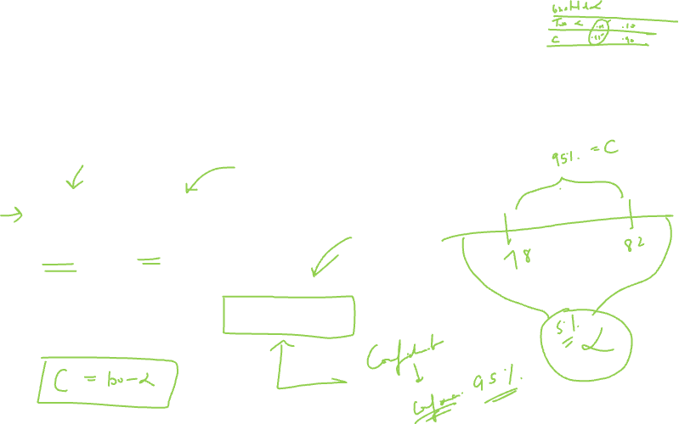
Interval Estimate
When a range of values is provided as an estimate it is called Interval estimate.
Mean + /- error
80% + /- 2%
So the interval is : 78% to 82%

Slide 16
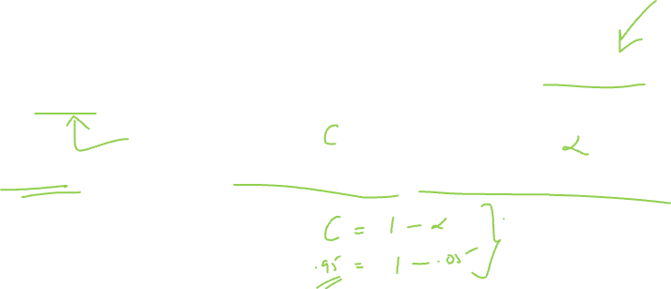
Concept of Interval Estimate
When an interval estimate is calculated it is based the sample mean and the error calculation.
This error depends on the confidence level ( 1 – level of significance)

Slide 17
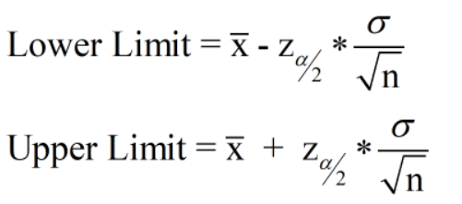
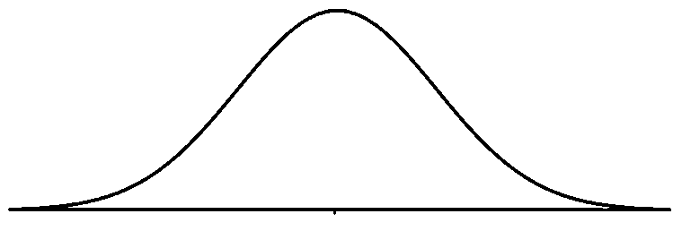
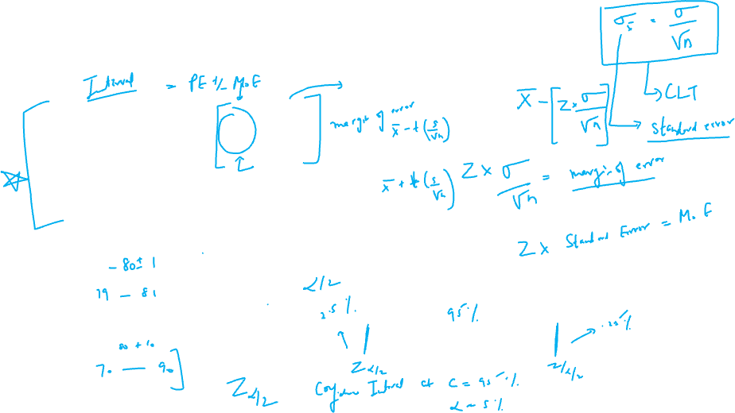
Formula of confidence interval

Slide 18
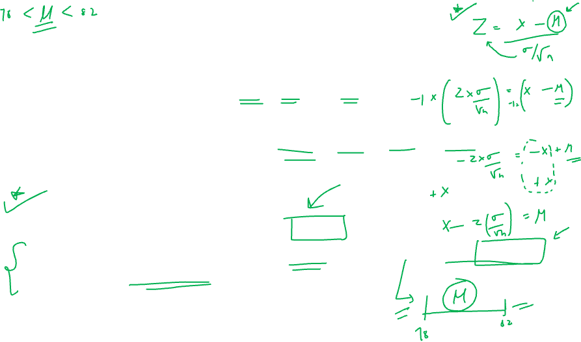
Alpha (level of significance) + Confidence level = 100%
General values of alpha = 1% , 5% and 10%
General values of confidence level ( c ) = 99% , 95% and 90%
Interpretation of confidence intervals:
Suppose if I get 95% confidence interval as (78, 82):
this implies that if 100 samples are taken, 95 of them will have the true population mean in the range 78 to 82.

Slide 19
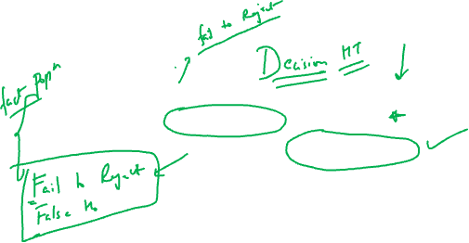
Type I and Type II errors ( hypothesis Testing)
Type I Error:
Rejecting a true null hypothesis
 | Accept Null | Reject Null
Null is True | Correct decision | Type I error
Null is False | Type II error | Correct decision
Type II Error:
Accepting a false null

Slide 20
Example: Crime detection
 | Accept Null | Reject Null
Null is True | Correct decision | Type I error
Null is False | Type II error | Correct decision
Null hypothesis: Person is NOT guilty
Alternate hypothesis: Person is guilty
Actual: Null is true : Person is NOT guilty
Prediction: Person is guilty (Wrong decision) ---- Type I error

Slide 21
Example: Crime detection
 | Accept Null | Reject Null
Null is True | Correct decision | Type I error
Null is False | Type II error | Correct decision
Null hypothesis: Person is NOT guilty
Alternate hypothesis: Person is guilty
Actual: Person is guilty ( Null is False)
Prediction: Person is not guilty ….Type II Error

